Slide 1
RELATION BETWEEN ELITE AND NON-ELITE USER SENTIMENTS AND BUSINESS RATING CLASSIFICATION USING YELP DATA
VISHWAJEET KHADILKAR (X17169984)
SHIKHAR SRIVASTAVA (X18106960)
RICARDO SALOMAO DA SILVA JR. (X18147607)
LALIT PATHAK (X18110088)
SUBMITTED TO: PROF. ADE FAJEMISIN

Slide 2


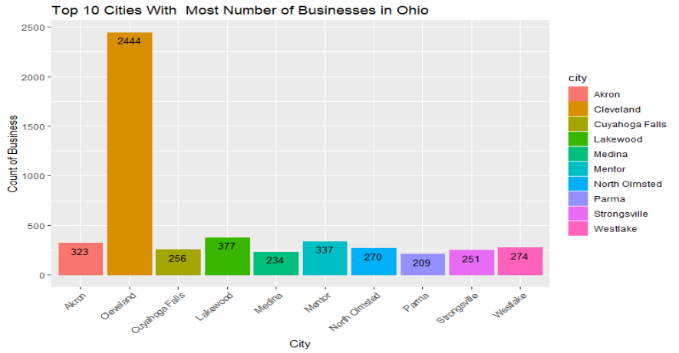

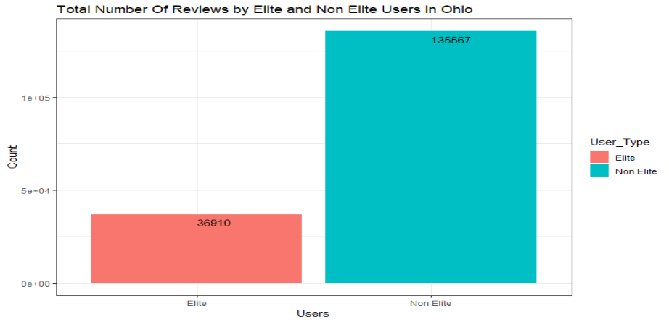
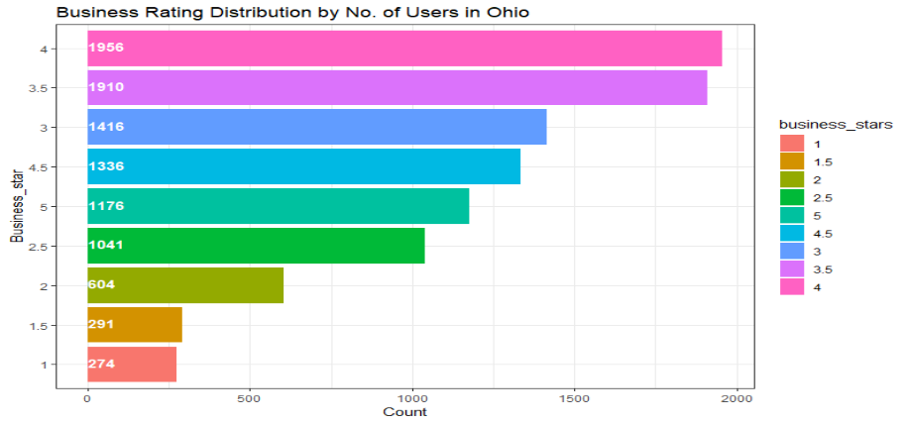
INTRODUCTION
Yelp dataset is subset of Yelp business Data.
There are Total 5 files in the dataset.
Dataset contains 1.2M reviews
400K tips by 250K users for 42K businesses
Social network of 250K users for a total of
1.9M social edges.

Slide 3
RESEARCH QUESTION AND DATA PREPROCESSING
Research questions:
  Do the reviews given by elite users have any impact on reviews given by normal users?
  Which model among KNN, SVM and C5.0 can classify star rating of businesses and achieve better results?
Data Pre-processing:
  Joins, Filtering and Cleaning
  Calculated (Custom) Columns
  Sentiment Analysis
  Data Imbalance
Notes:
[business_id and user_id]
[Star_Rating and Elite Flag]
[Removal of Punctuation, white spaces, special characters and numbers, Stop-words. CLD library – for Selecting English words]
[Reduction of Classes, under-sampling]

Slide 4
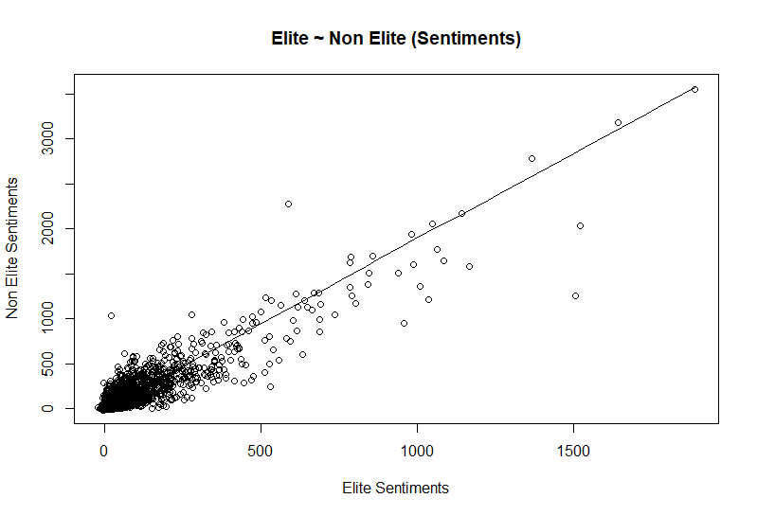
LINEAR REGRESSION
Built to answer our first research question.
Linear Equation :-
Y = 1.599063X + 14.891984
R² = 0.8228 P-value < 2.2e-16

Slide 5
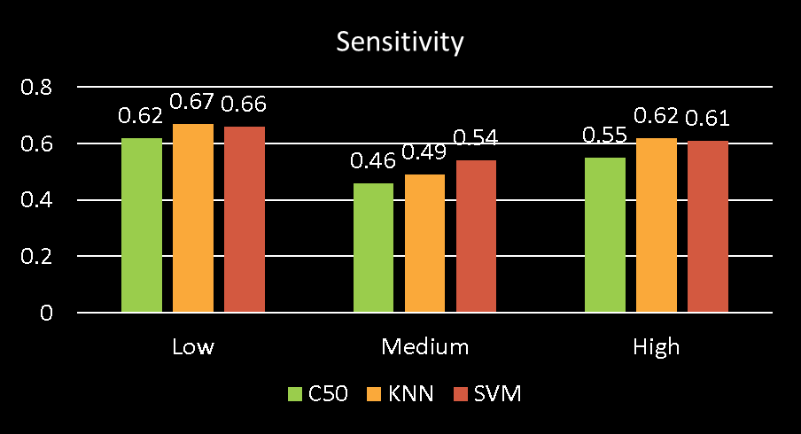

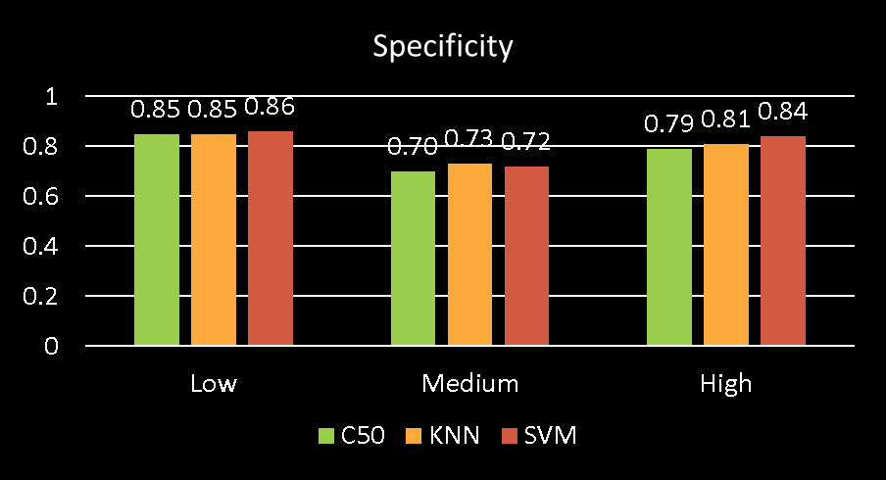
MODEL RESULTS
C5.0
KNN
SVM
Notes:
Kappa: C50(33)fair, KNN(40)moderate, SVM(41)moderate agreement between predictions and true values

Slide 6
CONCLUSION & FUTURE WORK
Strong relationship between elite and non-elite user sentiments(Linear Regression).
SVM gave slightly better performance results for classification of business star rating with 61% accuracy. C5.0 gave the worst.
Future Work
  All States
  Boosting Algorithm
  Ensemble
  Feature Selection using PCA
  Neural Network

Slide 7
THANK YOU!

